Slide 1
Line Sort Animation

Slide 2
Large Classes

Slide 3
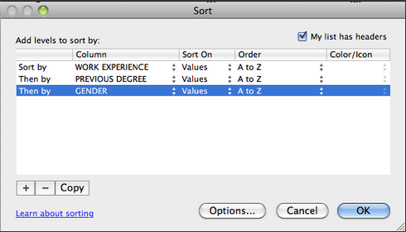
Online
Survey
Download results use Excel to build teams
Post teams and build classroom map
Team formation in large classes – use online survey and build teams from results – using nested sorting in Excel – actually same process as forming a line and counting off, but electronic

Slide 4
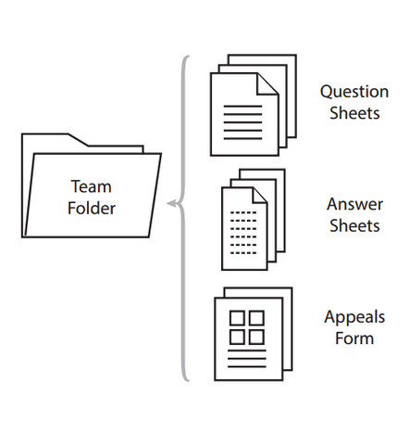
Use Barbara Millis team folders idea in large classes – makes handle of paper much more efficient – we ask each team to send a representative to front of class to collect teams folder

Slide 5
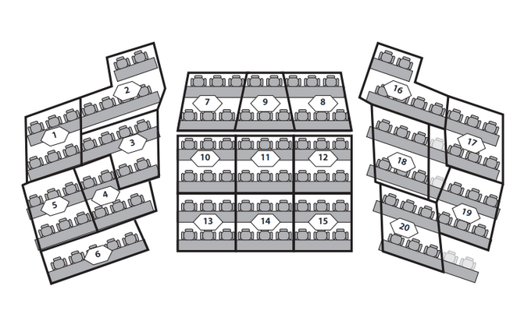
Using classroom map so students know where to find their teammates – team of 6 in a tiered lecture hall gives the best team shape

