Slide 1
Building Better Classes
Jim Sibley
Director – Centre for Instructional Support
University of British Columbia
February 19, 2019

Slide 2
What are some myths and facts about lectures?
How can I better organize my classes?
How can I use SET-BODY-CLOSE model to increase my teaching effectiveness?
How can I use Classroom Assessment Techniques to punctuate my lectures?

Slide 4
Are Lectures Bad?

Slide 5
Lectures can be effective to:
transmit information
validate student generated learning gains after activities.
help students organize more coherent frameworks of understanding after self-exploration.
convey the enthusiasm of the teacher for the discipline.
Lectures can be ineffective to:
promote deep thought (discussion or activities better).
change student attitudes.
teach behavioural skills.

Slide 6
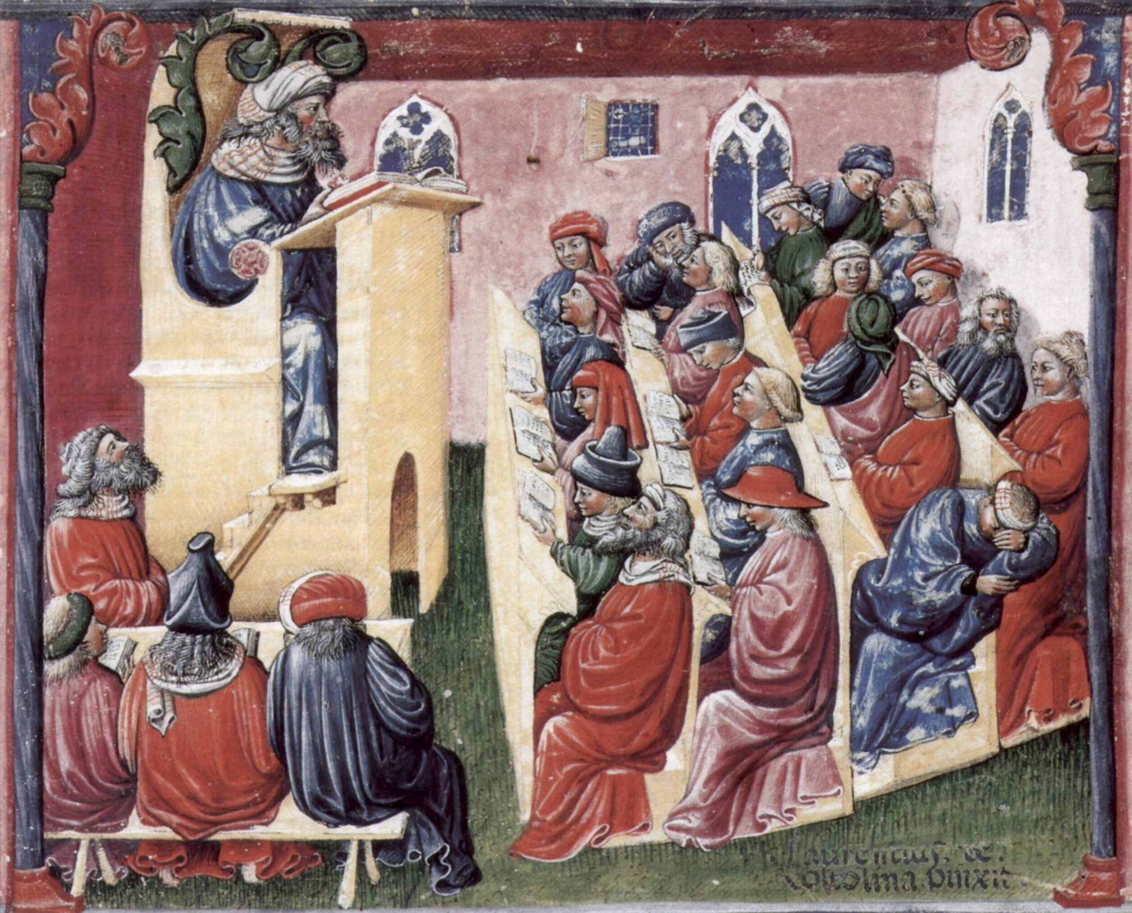
The power of punctuated lectures

Slide 7
The real question is not are lecture bad or good but how to use them effectively
Notes:
Two ideas are low hanging fruit for improving lectures
First, is more thought planning them – sequencing, repetition, reinforcement, reflection moments – which will lead us to talk about lesson planning is a moment
Second. Is incorporate thoughtful activities to get students actively working with the course content – not just sitting there trying to ABSORB it

Slide 8
Lesson Planning increases instructional effectiveness

Slide 9
Common Organizational Strategies
Concrete to Concept
Whole-Part-Whole
Naive Problem-Solving – when to provide examples/case studies
Content uncovering rather than content covering

Slide 10
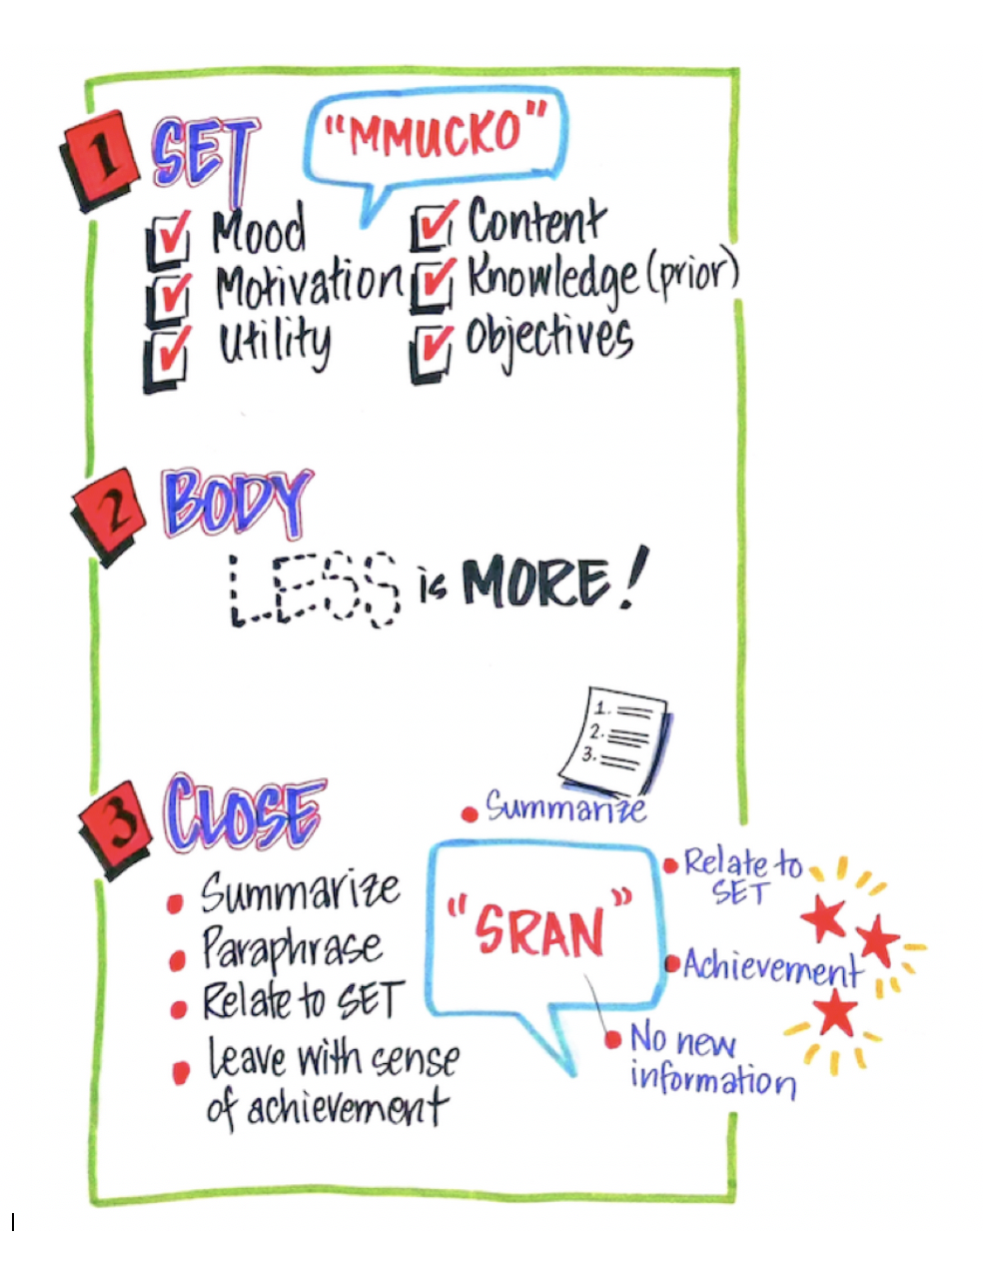

Slide 11
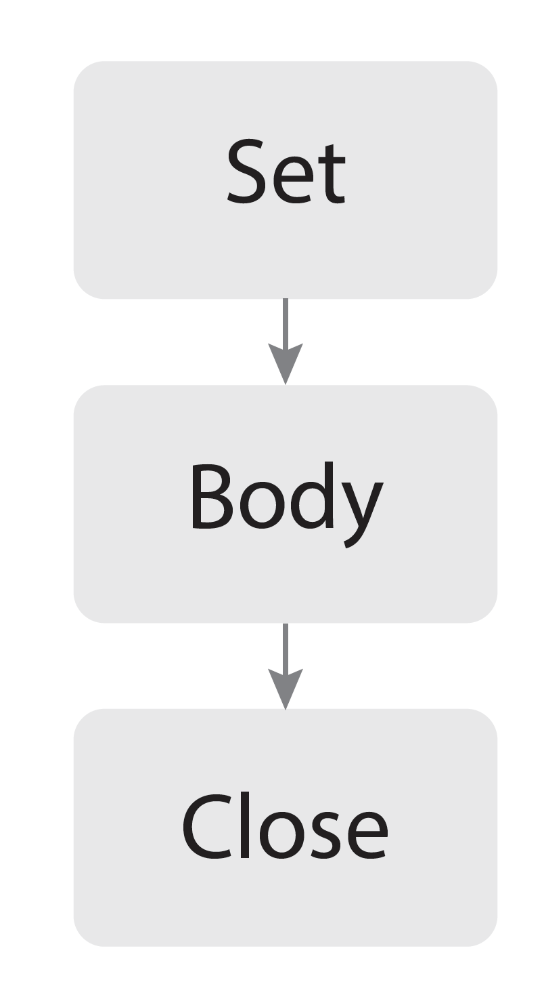
Set the stage: establish the tone, convey why the topic is important, and outline the objectives.
Main instruction – focus on a few topics - activities, discussions, videos, lectures – change stimuli periodically
Summary, relation to the Set, and emphasizing what has been accomplished

Slide 12
Build your First Lesson Plan
Think of a class you just gave or are about to give, then fill out the body section of handout with topics from class
Your Task is to think about the SET and CLOSE phase to bookend your content/body

Slide 13
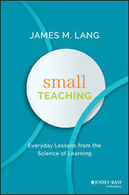
Lesson Planning – things to include
Set – start instruction well – set tone, motivate, and establish clear goals
Body – organize instruction for maximum effect
Use short lecture segments
Pauses for students to note-take/think/reflect
Ask students to make predictions
Repeat and Interleave the content
Have students retrieve what they know
Have students practice explaining – think out loud problem-solving
Have students practice using course content (TBL)
Help students make important connections
Close - with an integrating summary

Slide 14
Adding Activities to your classes – first small steps
Notes:
Two ideas are low hanging fruit for improving lectures
First, is more thought planning them – sequencing, repetition, reinforcement, reflection moments – which will lead us to talk about lesson planning is a moment
Second. Is incorporate thoughtful activities to get students actively working with the course content – not just sitting there trying to ABSORB it

Slide 15
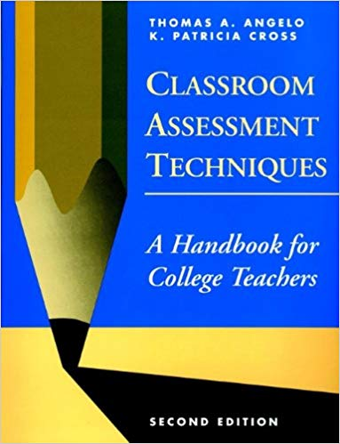
Classroom Assessment Techniques (CATs) are generally simple, non-graded, anonymous, in-class activities designed to give you and your students useful feedback on the teaching-learning process as it is happening.
Easy recipes to bring active learning to your classroom easily.

Slide 16
One Minute Paper - Example CAT
Basic Strategy
One minute paper is a popular non-graded, end of class Classroom Assessment Technique that requires minimal preparation. During a one minute paper exercise students are given one minute to write a response to a prompt or question posed by the instructor. Minute papers are then collected for review by the instructor.
Why would you use it?
Can provide valuable reflection opportunity for students.
Can give instructor feedback on student experience.
Can be easily facilitated in any class size.
How does it work?
Decide what you want to focus on, what you want students to reflect on.
Write Minute Paper prompt that meets your goal. These prompts are the heart of one minute papers.
Set aside 3-5 minutes at end of class to let student write.
Let students know how much time they will have, what kinds of detail you are looking for (words, bullets, short sentences), and how you are going to use them.
Collect the Minute Papers as students leave.
Read and if you like bring some student comments back to the next class meeting.
Sample Minute Paper prompts:
Questions Designed to Assess Student Interests: What interesting questions remain unanswered about today’s topic?
Identifying Perceived Relevance of Course Concepts: What idea(s) struck you as things you could put into practice?
Assess Student Attitudes/Opinions: Were there any ideas expressed that caused you to reconsider or change your personal? opinions, viewpoints, or values?
Checking Student Comprehension: What were the 3 main take-away’s for you today? What still remains confusing?

Slide 17
Write a one minute paper prompt for one of your classes

Slide 18
Consistent Format – CATs are presented as recipes
Time and Energy Estimates*
Description
Purpose
Suggestions for use
Examples
Step-by-Step Procedures
Ideas for Adapting and Extending
Pros/Cons/Caveats
References
* estimates time and energy for faculty to prepare and to analyze data collected, and for students to respond to assessment

Slide 19
Techniques for Course-Related Knowledge and Skills:
Assessing Prior Knowledge, Recall, and Understanding (7)
Assessing Skills in Analysis and Critical Thinking (5)
Assessing synthesis and Creative Thinking (6)
Assessing Skill in Problem-Solving (4)
Assessing Skill in Application and Performance (5)
Techniques for Assessing Learner Attitudes, Values and Self-Awareness:
Assessing Students’ Awareness of their Attitudes and Values (5)
Assessing Students’ Self-Awareness as Learners (4)
Assessing Course-Related Learning, Study Skills and Strategies (4)
Techniques for Assessing Learner Reaction to Instruction:
Assessing Learner Reaction to Teachers and Teaching (5)
Assessing Learner Reaction to Class Activities and Assignments (5)

Slide 20
Simple Steps for Better Classes
Lecture for the right reason, in the right amounts, and the right way
Plan your lessons - SET-BODY-CLOSE
Add activities in your classes – CAT’s and (TBL)
Notes:
Uncover content rather then cover content – I love the Wiggins and McThige idea from their book Understanding by design

Slide 21
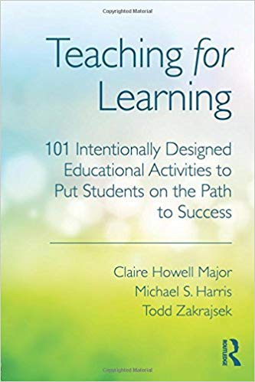
Notes:
Uncover content rather then cover content – I love the Wiggins and McThige idea from their book Understanding by design

Slide 22
Questions
jim.sibley@ubc.ca

Slide 23
Burning Questions
What topics would you like discussed before end of today? Write on Post-it’s – dotmocracy over lunch – will try to answer requests at end of day

